Slide 1
Visualizations in Tableau
File created on: 1/30/2022 8:25:25 AM

Slide 2


Slide 3
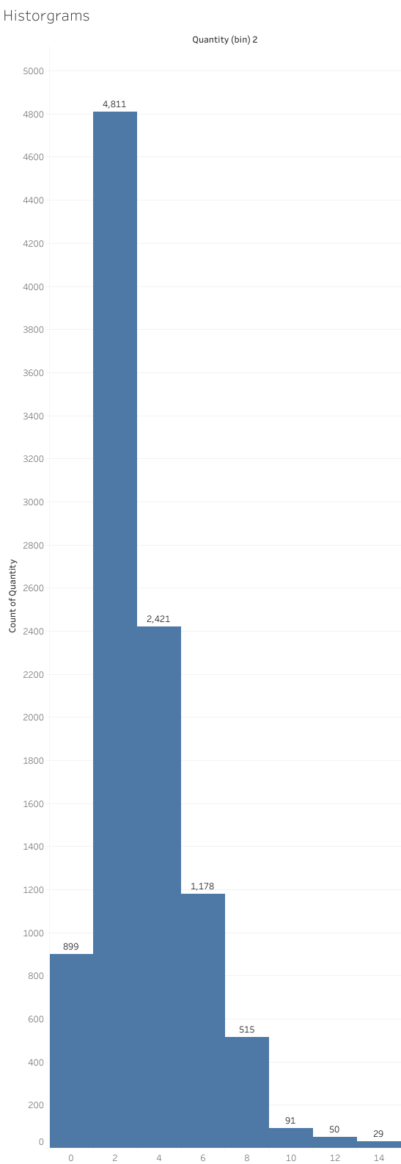

Slide 4
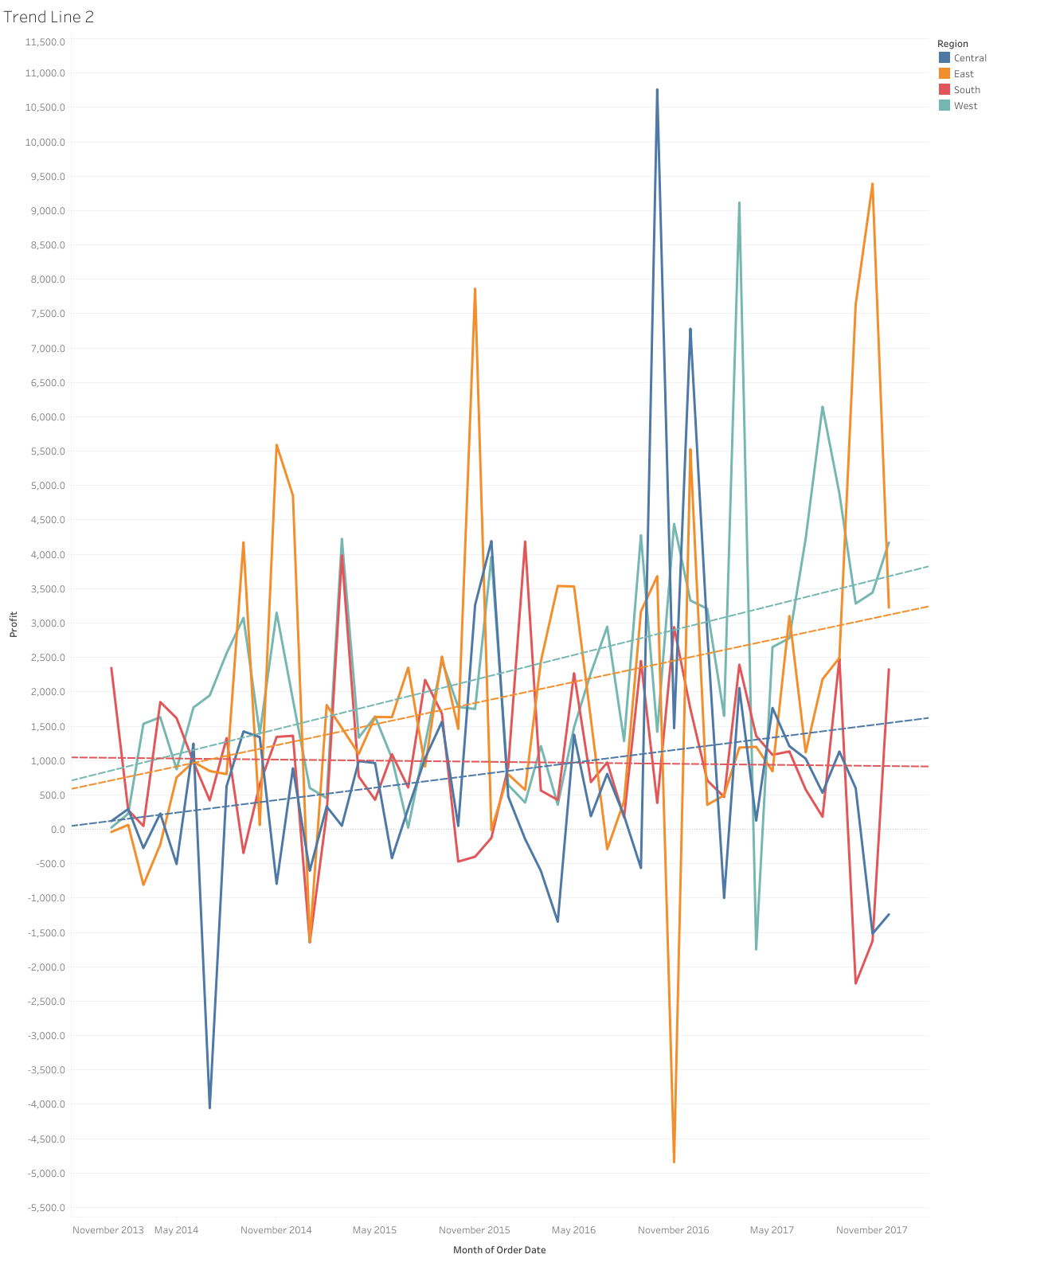

Slide 5
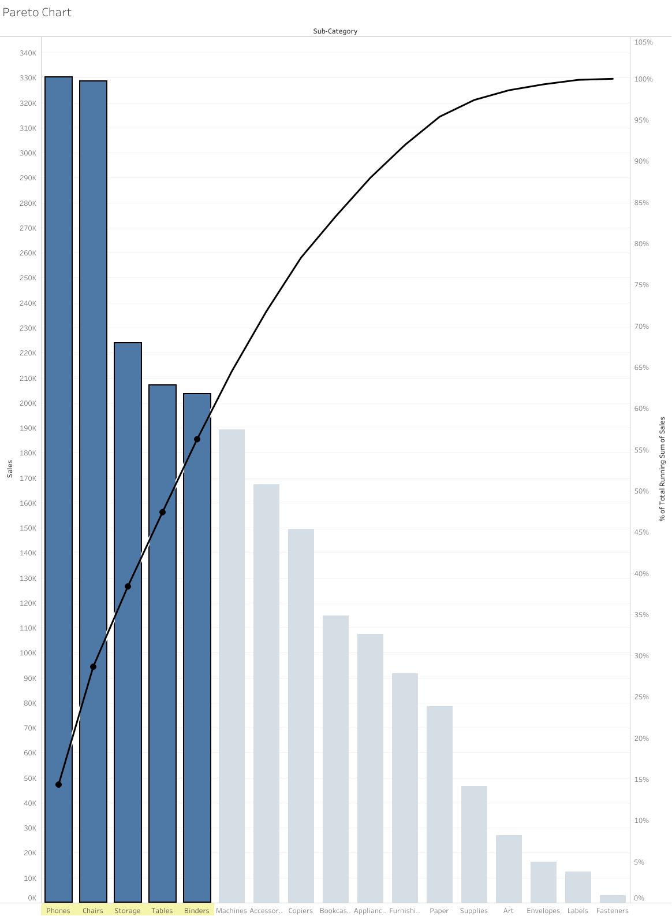

Slide 6
